Slide 1

COPILOT DEMO BRIEFING
WARHAMMER
News
Radar
A five-page fan-facing scan of the hobby news cycle — tabletop, fantasy, specialist games, and the wider Warhammer attention machine.
Demo note: built without live web research; treat exact announcements as a refresh step before sharing externally.
01

Slide 2
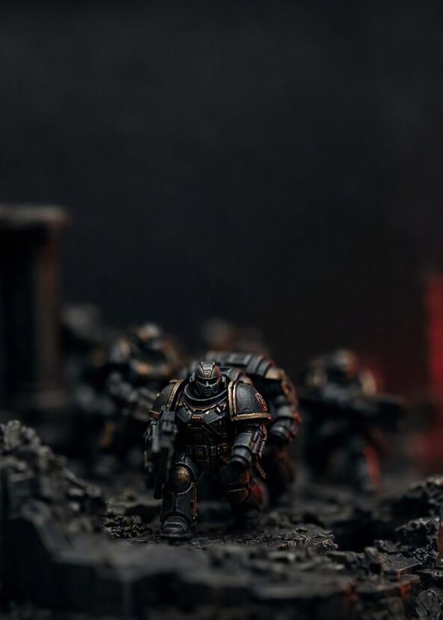
01 / WARHAMMER 40,000
40K remains the headline engine
For existing fans, the news rhythm is less one launch and more an always-on cadence.
01
Codex & balance cadence
Faction books, detachments and dataslates keep the meta moving between big boxed releases.
02
Narrative arcs as release fuel
Campaign beats give new kits a reason to exist beyond the rules update.
03
Entry formats matter
Combat Patrol, Kill Team and boxed games turn “what’s new?” into “what can I play fast?”
40K NEWS SIGNAL
Fan shorthand: expect the hot topic to jump quickly from reveal stream to preorder debate to table impact.
02

Slide 3
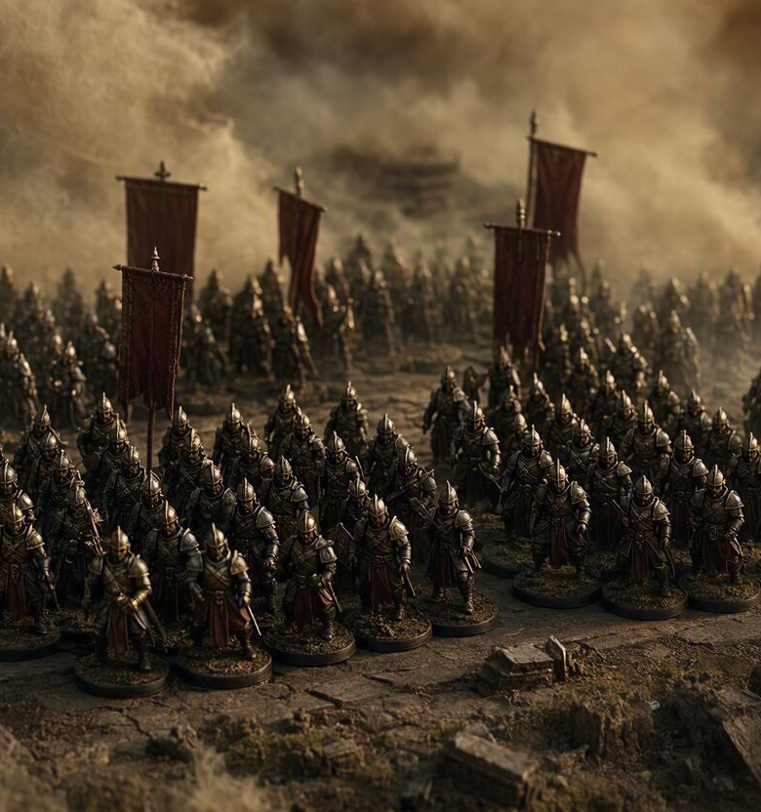
02 / FANTASY SHELF
Fantasy news is now a multi-lane story
Age of Sigmar, The Old World and boxed games each speak to a different kind of fan energy.
AGE OF SIGMAR
THE OLD WORLD
SPECIALIST BOXES
Edition support, battletomes and spearhead-style play keep the fantasy flagship accessible.
Rank-and-flank nostalgia brings resin, plastic and lore arguments back to the front rank.
Necromunda, Blood Bowl and related games create compact, characterful news moments.
Lore
Models
Format
The practical takeaway: “Warhammer news” is no longer one pipeline — it is a rotating shelf of systems, each with its own reveal cadence.
03

Slide 4
03 / BEYOND THE TABLETOP
The wider ecosystem turns releases into conversation
Fans increasingly track models, lore, shows, games, events and creators as one attention flywheel.
Rules updates
Model reveals
WHY IT MATTERS
A reveal can start as a miniature, get amplified by a novel or stream, then land as a list-building debate.
WHAT FANS WATCH
HOBBY
ATTENTION
Official previews, preorder windows, balance commentary, creator reactions and local-event uptake.
Black Library
Video games & licensing
Events & community
04

Slide 5

04 / TALK TRACK FOR ELIJAH
Three things to say out loud
A compact ending for the live Copilot demo.
01
News cadence is the product
Warhammer stays visible by keeping reveals, rules and hobby content in motion.
02
The hook changes by system
40K, AoS, Old World and specialist games each have different fans and buying moments.
03
Refresh before publishing
For exact “latest” dates, pull Warhammer Community headlines immediately before presenting.
Next stop: reveal article → preorder page → hobby desk.
05

